Slide 1
Plano Percussion
Parent Ensemble
Class of 2022, 13th Graders

Slide 2
2022 Spettacolo: Inferno – PPPE 13th Graders
Jeremy Bailey

Slide 3
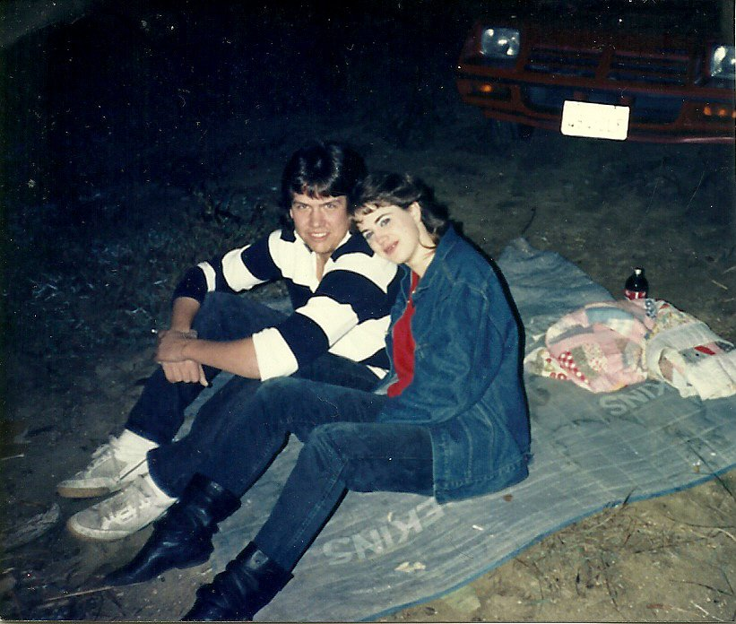
2022 Spettacolo: Inferno – PPPE 13th Graders
Kristen & John Butler

Slide 4
2022 Spettacolo: Inferno – PPPE 13th Graders
Jennifer Jorgensen Clinton

Slide 5
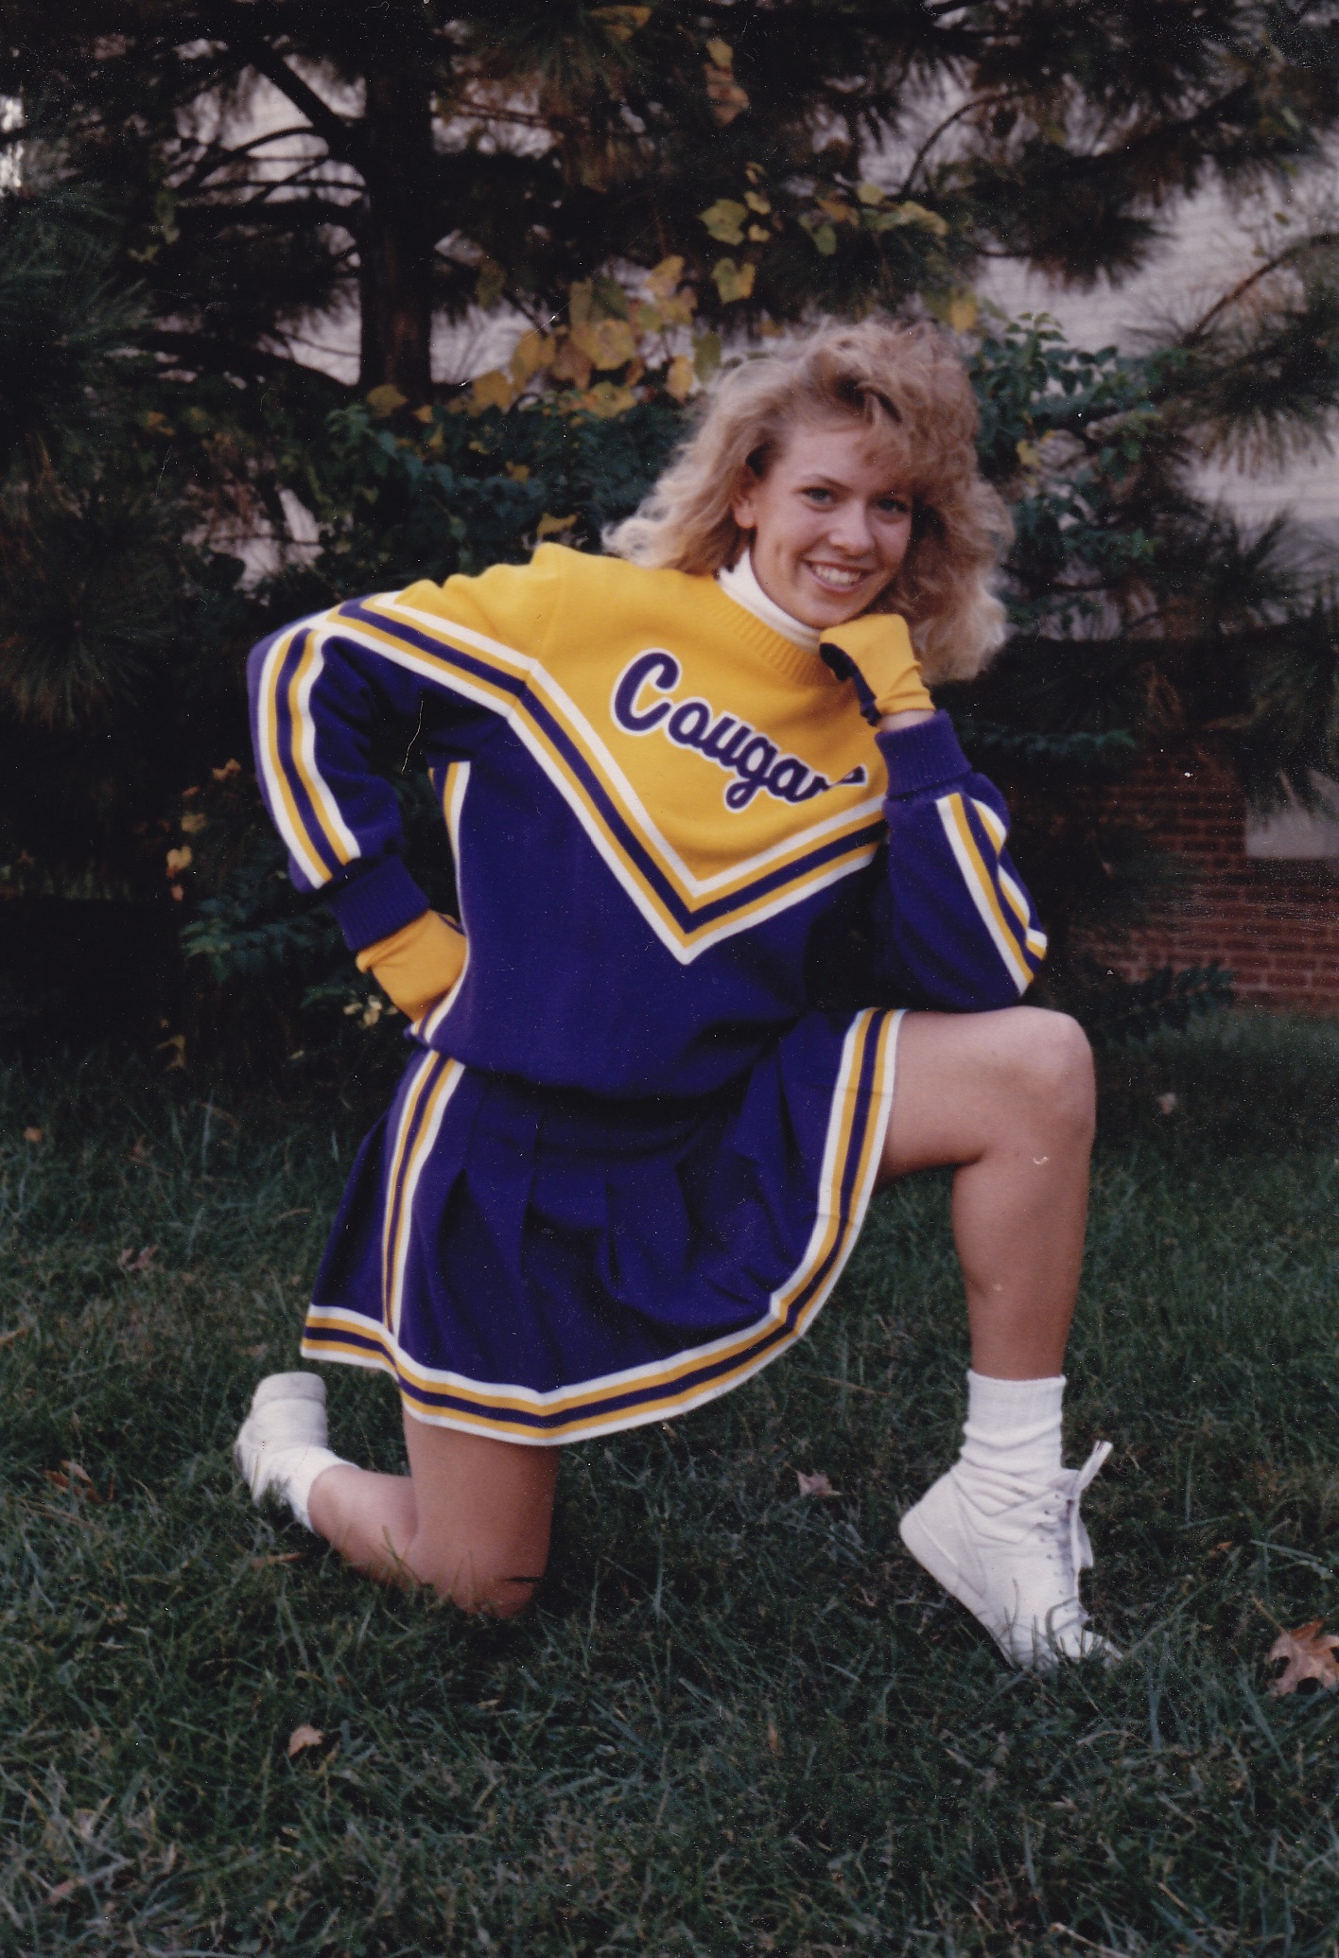
2022 Spettacolo: Inferno – PPPE 13th Graders
Jennifer Jacobs

Slide 6
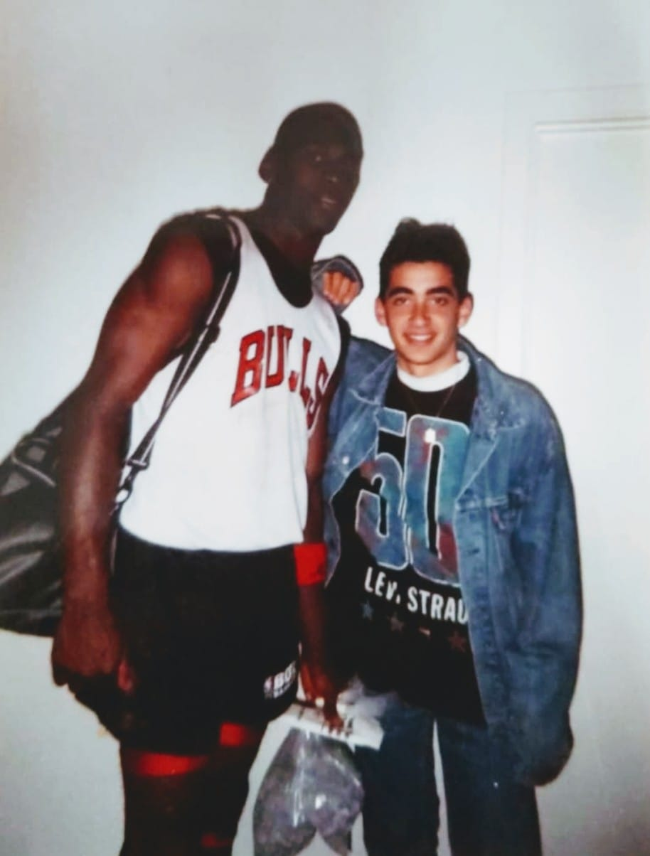
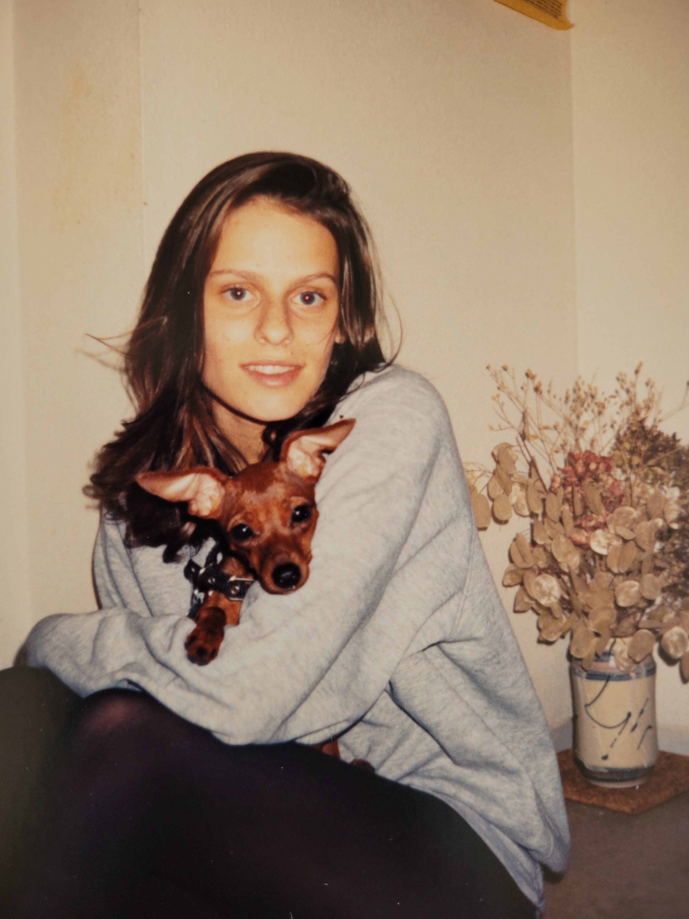
2022 Spettacolo: Inferno – PPPE 13th Graders
Ronni & Assaf Mor

Slide 7
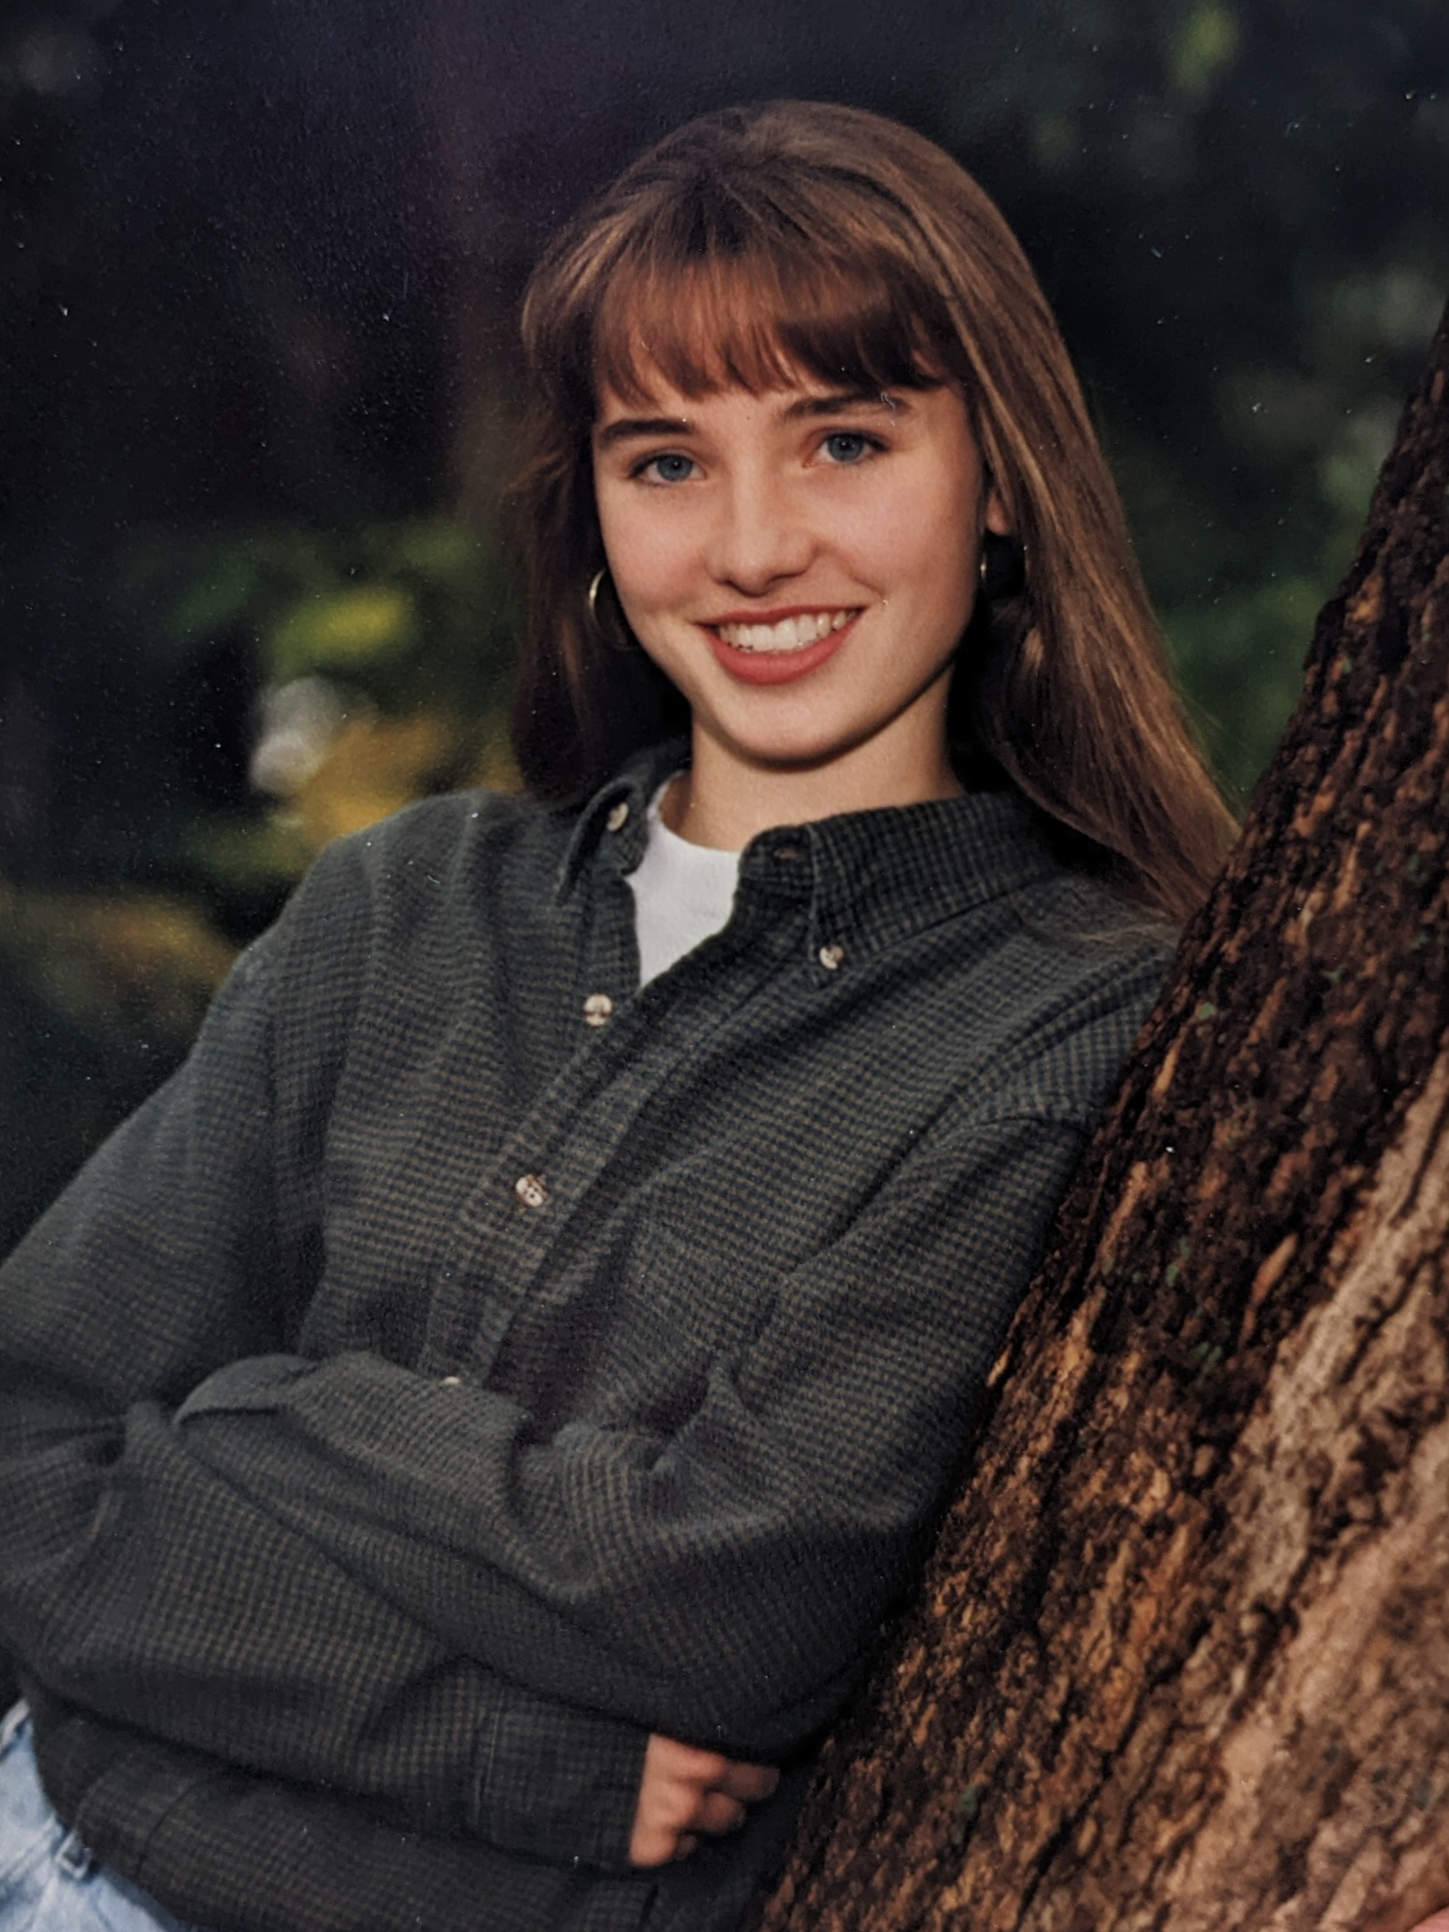
2022 Spettacolo: Inferno – PPPE 13th Graders
Jennifer Smith

Slide 8
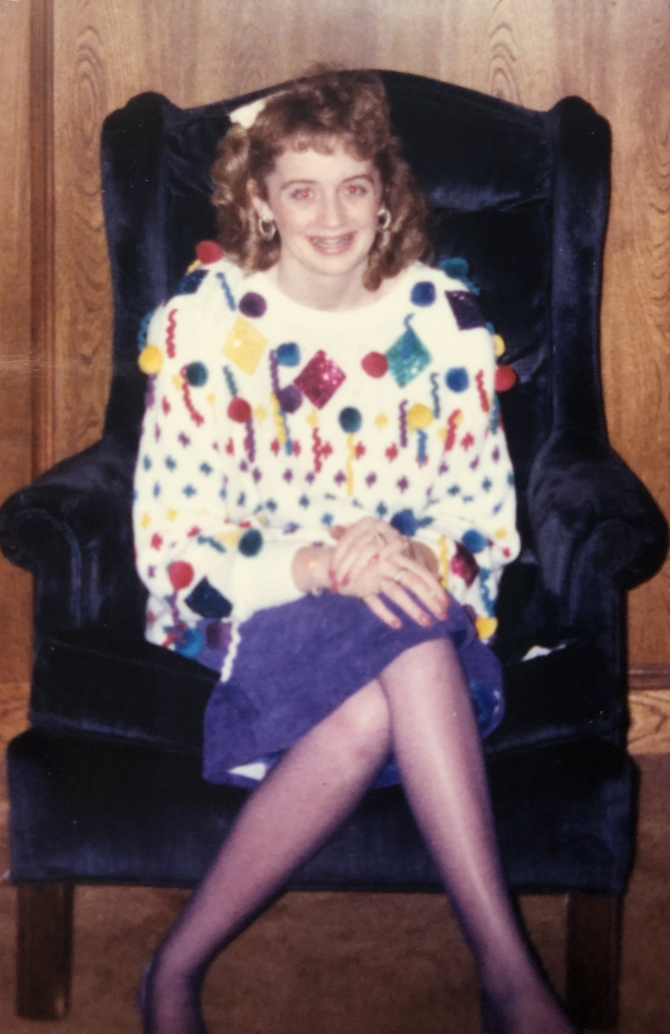
2022 Spettacolo: Inferno – PPPE 13th Graders
Kellee Stemac

Slide 9
Thank You
Plano Percussion
PPPE Class of 2022!
Stay Sweet And You’ll Go Far!
Have a Great Summer!
2 cool
+ 2 be
4 gotten

